Slide 1
LAKBAY - A THREE DIMENSIONAL GAME ABOUT DRIVING FUNDAMENTALS AND ROAD COURTESY AND SAFETY OF BACOOR MUNICIPALITY
By:
Hannie May G. Defacto
John Paul R. Consuelo
Nommel Isanar L. Amolat
BS Information Technology 3-2
Game Category: Educational

Slide 2
General Rules (Gameplay Constraints)
Two phases: Linear Play and Free-Roam Play.
Answer correctly all the questions in Linear Play's levels as you can.
Levels must be completed chronologically before succeeding to the next one.
Complete and pass the Linear Play to unlocked the Free-Roam
Complete the Missions in Free-Roam to finished the game
In Linear Play, you begin with 3 lives, 3 hints, and 10 coins but as you go along you can gain coins by answering questions correctly.
The Coins you earned can be used to buy Fuel in the game.
Fuel is what drives the vehicle.

Slide 3


Essentials
Essentials are assets that will help the player throughout the Linear Play. The default number of Essentials the player can possess are 25 coins, 3 hints, 3 lives, and 100 fuel.
Coins
Can be obtained by answering questions correctly.
Hints
Can be used to remove two wrong choices on a question.
Life
The number of times the player will respawn once the gas runs out.
Fuel
Fuel is what drives the player's vehicle, once it runs out game ends unless the player has remaining lives. Fuel can be refilled using the coins earned in the gameplay.
The default Fuel bar at the beginning of the game is fully refilled. Once the player died, the player will respawn with a half-filled Fuel tank.

Slide 4
Modes
There are two game modes in the game. Each mode runs through the two phases of the game. The only difference between the two is the complexity or some changes in the mechanics of the phases of the game.
Non-Professional Mode
The mode of the game…
Professional Mode
The mode of the game…

Slide 5
Phases
Phases are the points in the game that the player plays in each of the said two modes. There are two phases in the game that the players must deal with in order to finish the overall gameplay of the game.
Linear Play
The phase of the game wherein the player must answer a set of questions and pass the passing score to unlock the Free-Roam Play. It is composed of three stages. The number of questions per stage varies depending on the stage.
This phase is composed of three stages:
City Road
Provincial Road
National Road

Slide 6
Phases
Free-Roam Play
The phase of the game wherein the player must complete 11 missions on the play. The player can roam around the map to do each mission. The missions are categorized into five and every category has its subtopics.
Backing and Turning
Turning right and left in an intersection.
Backing inside or outside of the street.
Road Crossing and Light Traffic
Road crossing.
Driving at light traffic.
Maneuvering
The "Y" turn and about maneuvering style.
Garage Driving
Outside the garage.
Into the garage using the backing procedure.

Slide 7
Backing And Turning
Turning right and left in an intersection
Backing in/ outside of street
Road crossing
Driving at Light traffic
The "Y" turn and about maneuvering style.
Into the garage
Outside the garage
Into the garage using backing procedure.
Entering/leaving angle parking space
Perpendicular parking
Parallel parking
Road Crossing And Traffic
MISSIONS
Maneuvering
Garage Driving
Parking
Figure 1: Free-Roam Play Diagram

Slide 8
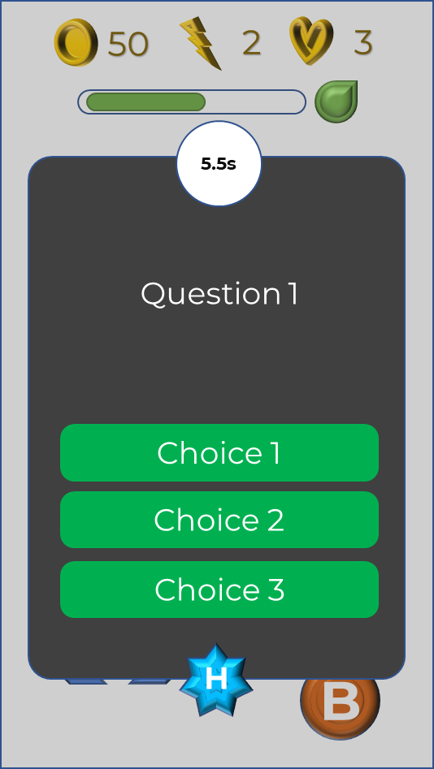
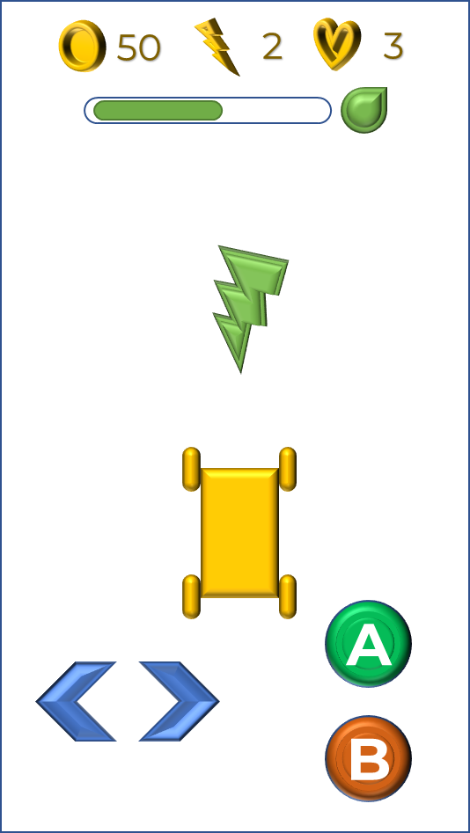
Timer
Hints Available
Coins Earned
Lives
Fuel Bar
Refill Button
Choices
Question
Vehicle
Left Button
Accelerate
Hint
Right Button
Break
Figure 2: Linear Play Diagram

Slide 9
Mission
Player/Vehicle
Minimap
Figure 3: Free-Roam Play Diagram

Slide 10
Phase Goals
Clear each stage and reach the passing score on your chosen category for Linear Play.
Clear each stage and reach the passing score on your chosen category for Linear Play.
By reaching the passing score on the Linear Play will unlock the Free-Roam Play.
CATEGORY | PASSING SCORE | No. Of Items
Non- Professional | 30 | 40
Professional | 45 | 60
Table 1: Passing Scores per Mode for Linear Play

Slide 11
Phases’ Goals
For Linear Play, as you progress each stage, questions begin to increase and become much harder to answer.
The mode that the user has chosen will have a different total number of questions.

Slide 12
CATEGORY
NON PROFESSIONAL
PROFESSIONAL
Level 1: City Road
(10 questions)
Easy
Level 1: City Road
(15 questions)
Level 2: Provincial Road
(15 questions)
Medium
Level 2: Provincial Road
(20 questions)
Level 3: National Road
(15 questions)
Hard
Level 3: City Road
(25 questions)
Figure 4: Linear-Play’s Stages Diagram

